Slide 1



Entertainers Data Analysis Project
View in Power BI
Last data refresh:
2/16/2023 6:18:59 AM UTC
Downloaded at:
2/16/2023 6:56:20 AM UTC

Slide 2
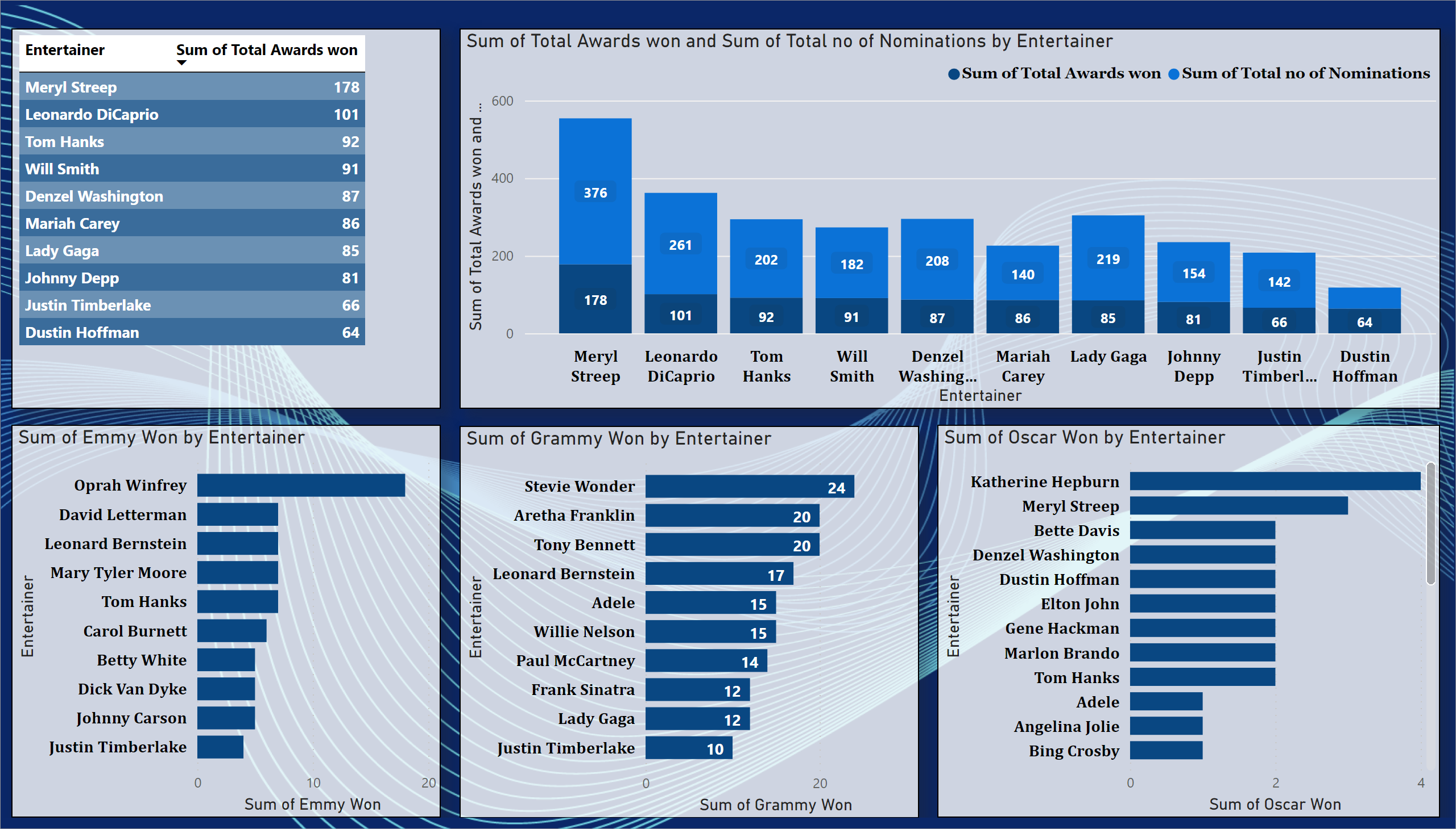
Overall
Meryl Streep and Leonard DiCaprio, who received the majority of nominations and awards, are clearly the top performers in the above graph, but if we look closely, Mariah Carey and Johnny Depp have the highest success rates at 61.4% and 52.6%, respectively.
It should be noted that Stevie Wonder, one of the best singers and songwriters, won the majority of Grammy awards in the singing category while Oprah Winfrey won the majority of Emmy awards over the years for various television programs.
Notes:
tableEx
No alt text provided
columnChart
No alt text provided
barChart
No alt text provided
barChart
No alt text provided
barChart
No alt text provided

Slide 3
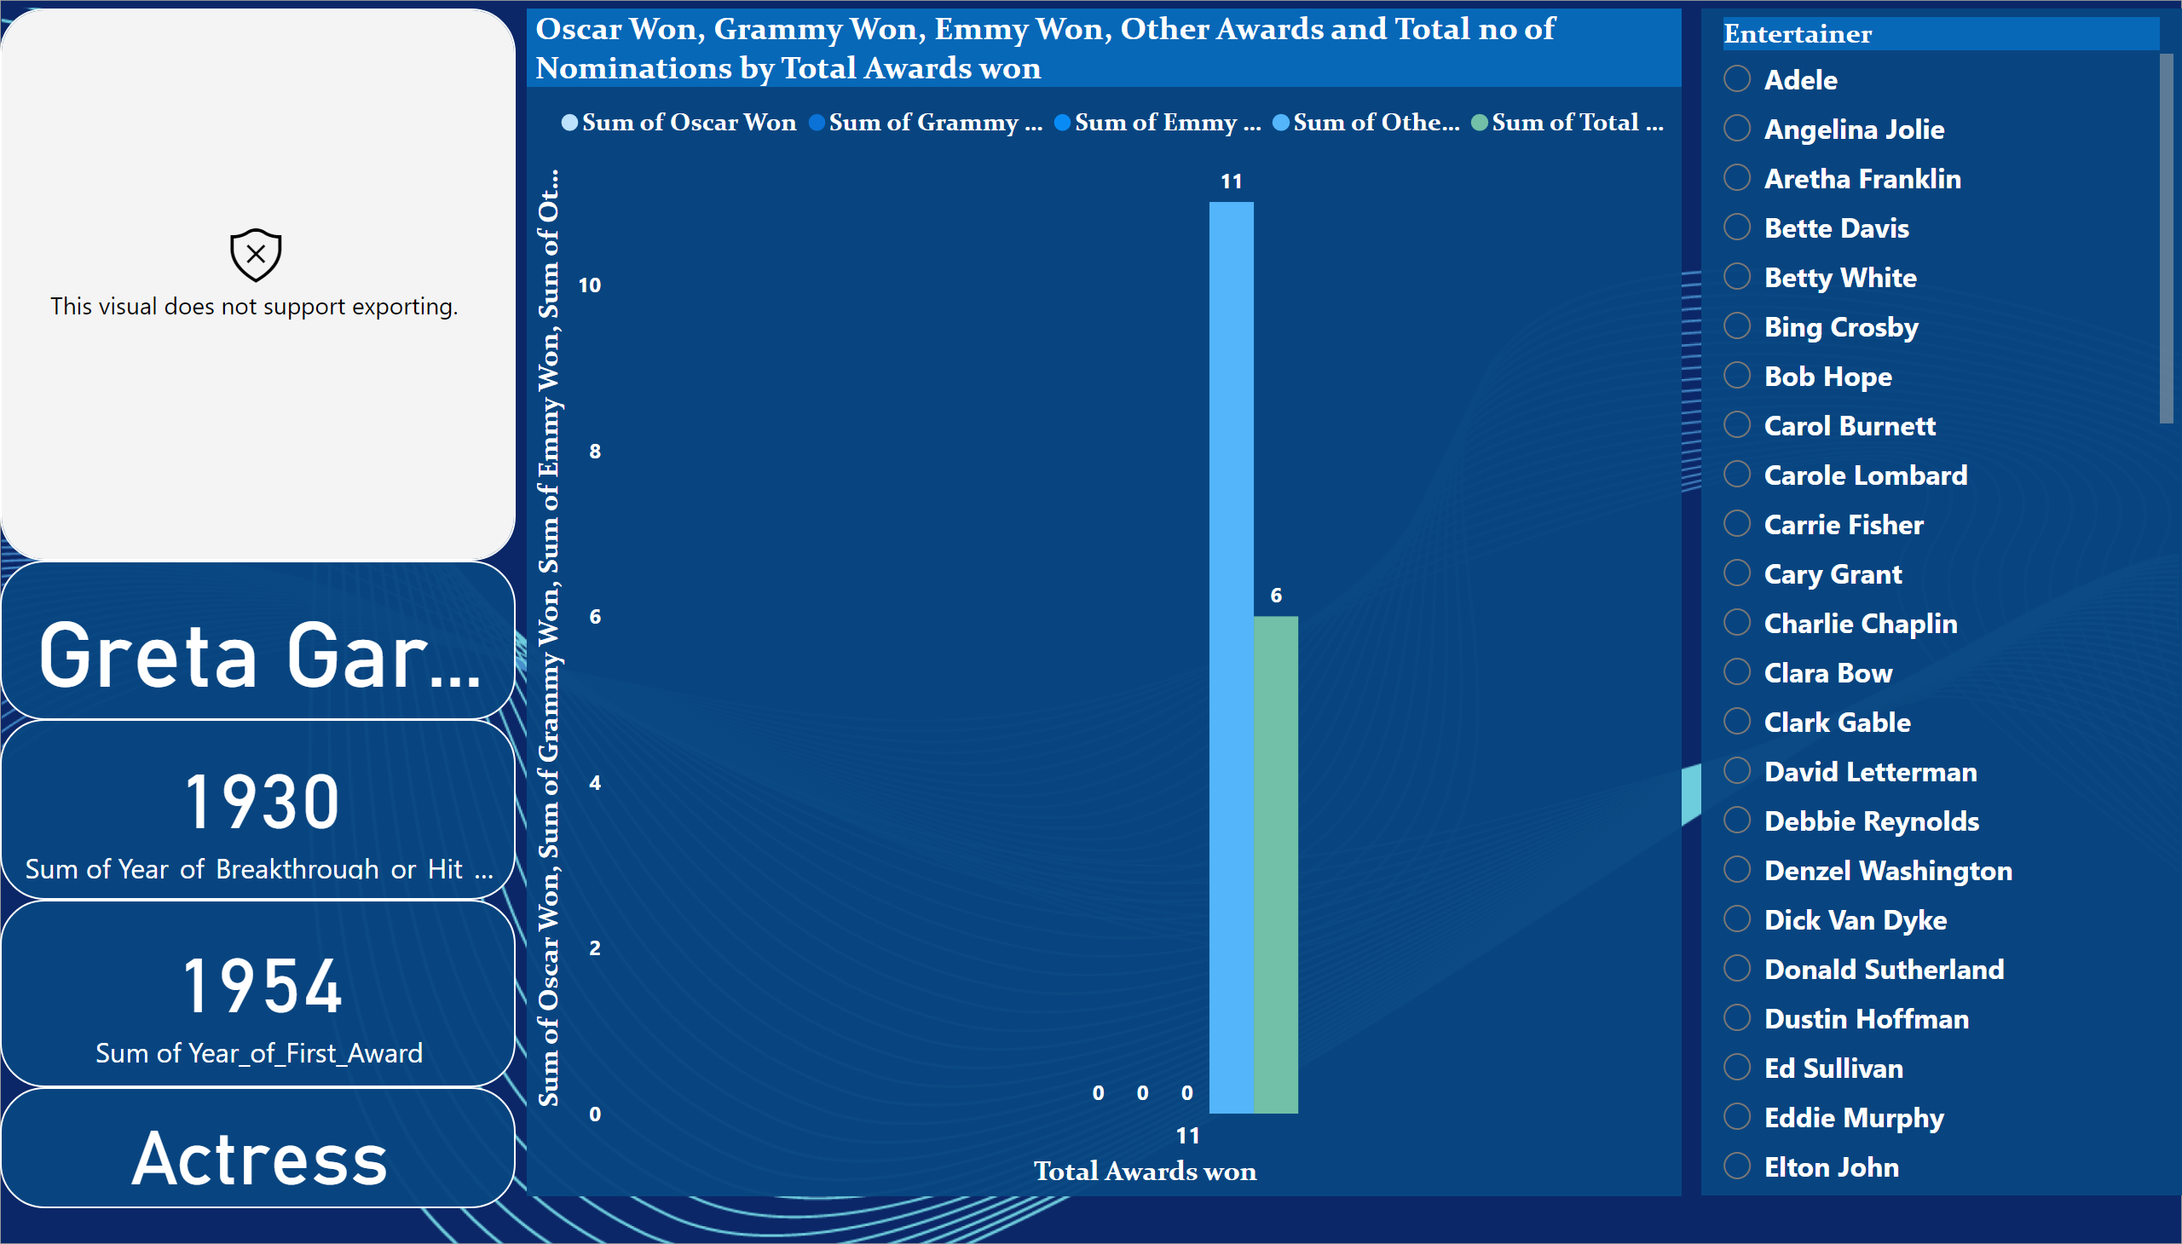
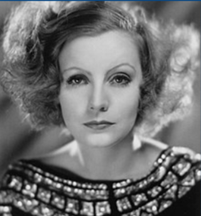
Individual Artist Report
Each performer is represented by their picture and career highlights on the dashboard above. To access the information for each entertainer's specific details, the user must first choose their name.
Notes:
slicer
No alt text provided
PBI_CV_81BBAD08_3ADD_466C_8819_9FACA21A6B8F
No alt text provided
Oscar Won, Grammy Won, Emmy Won, Other Awards and Total no of Nominations by Total Awards won
No alt text provided
card
No alt text provided
card
No alt text provided
card
No alt text provided
card
No alt text provided

Slide 4
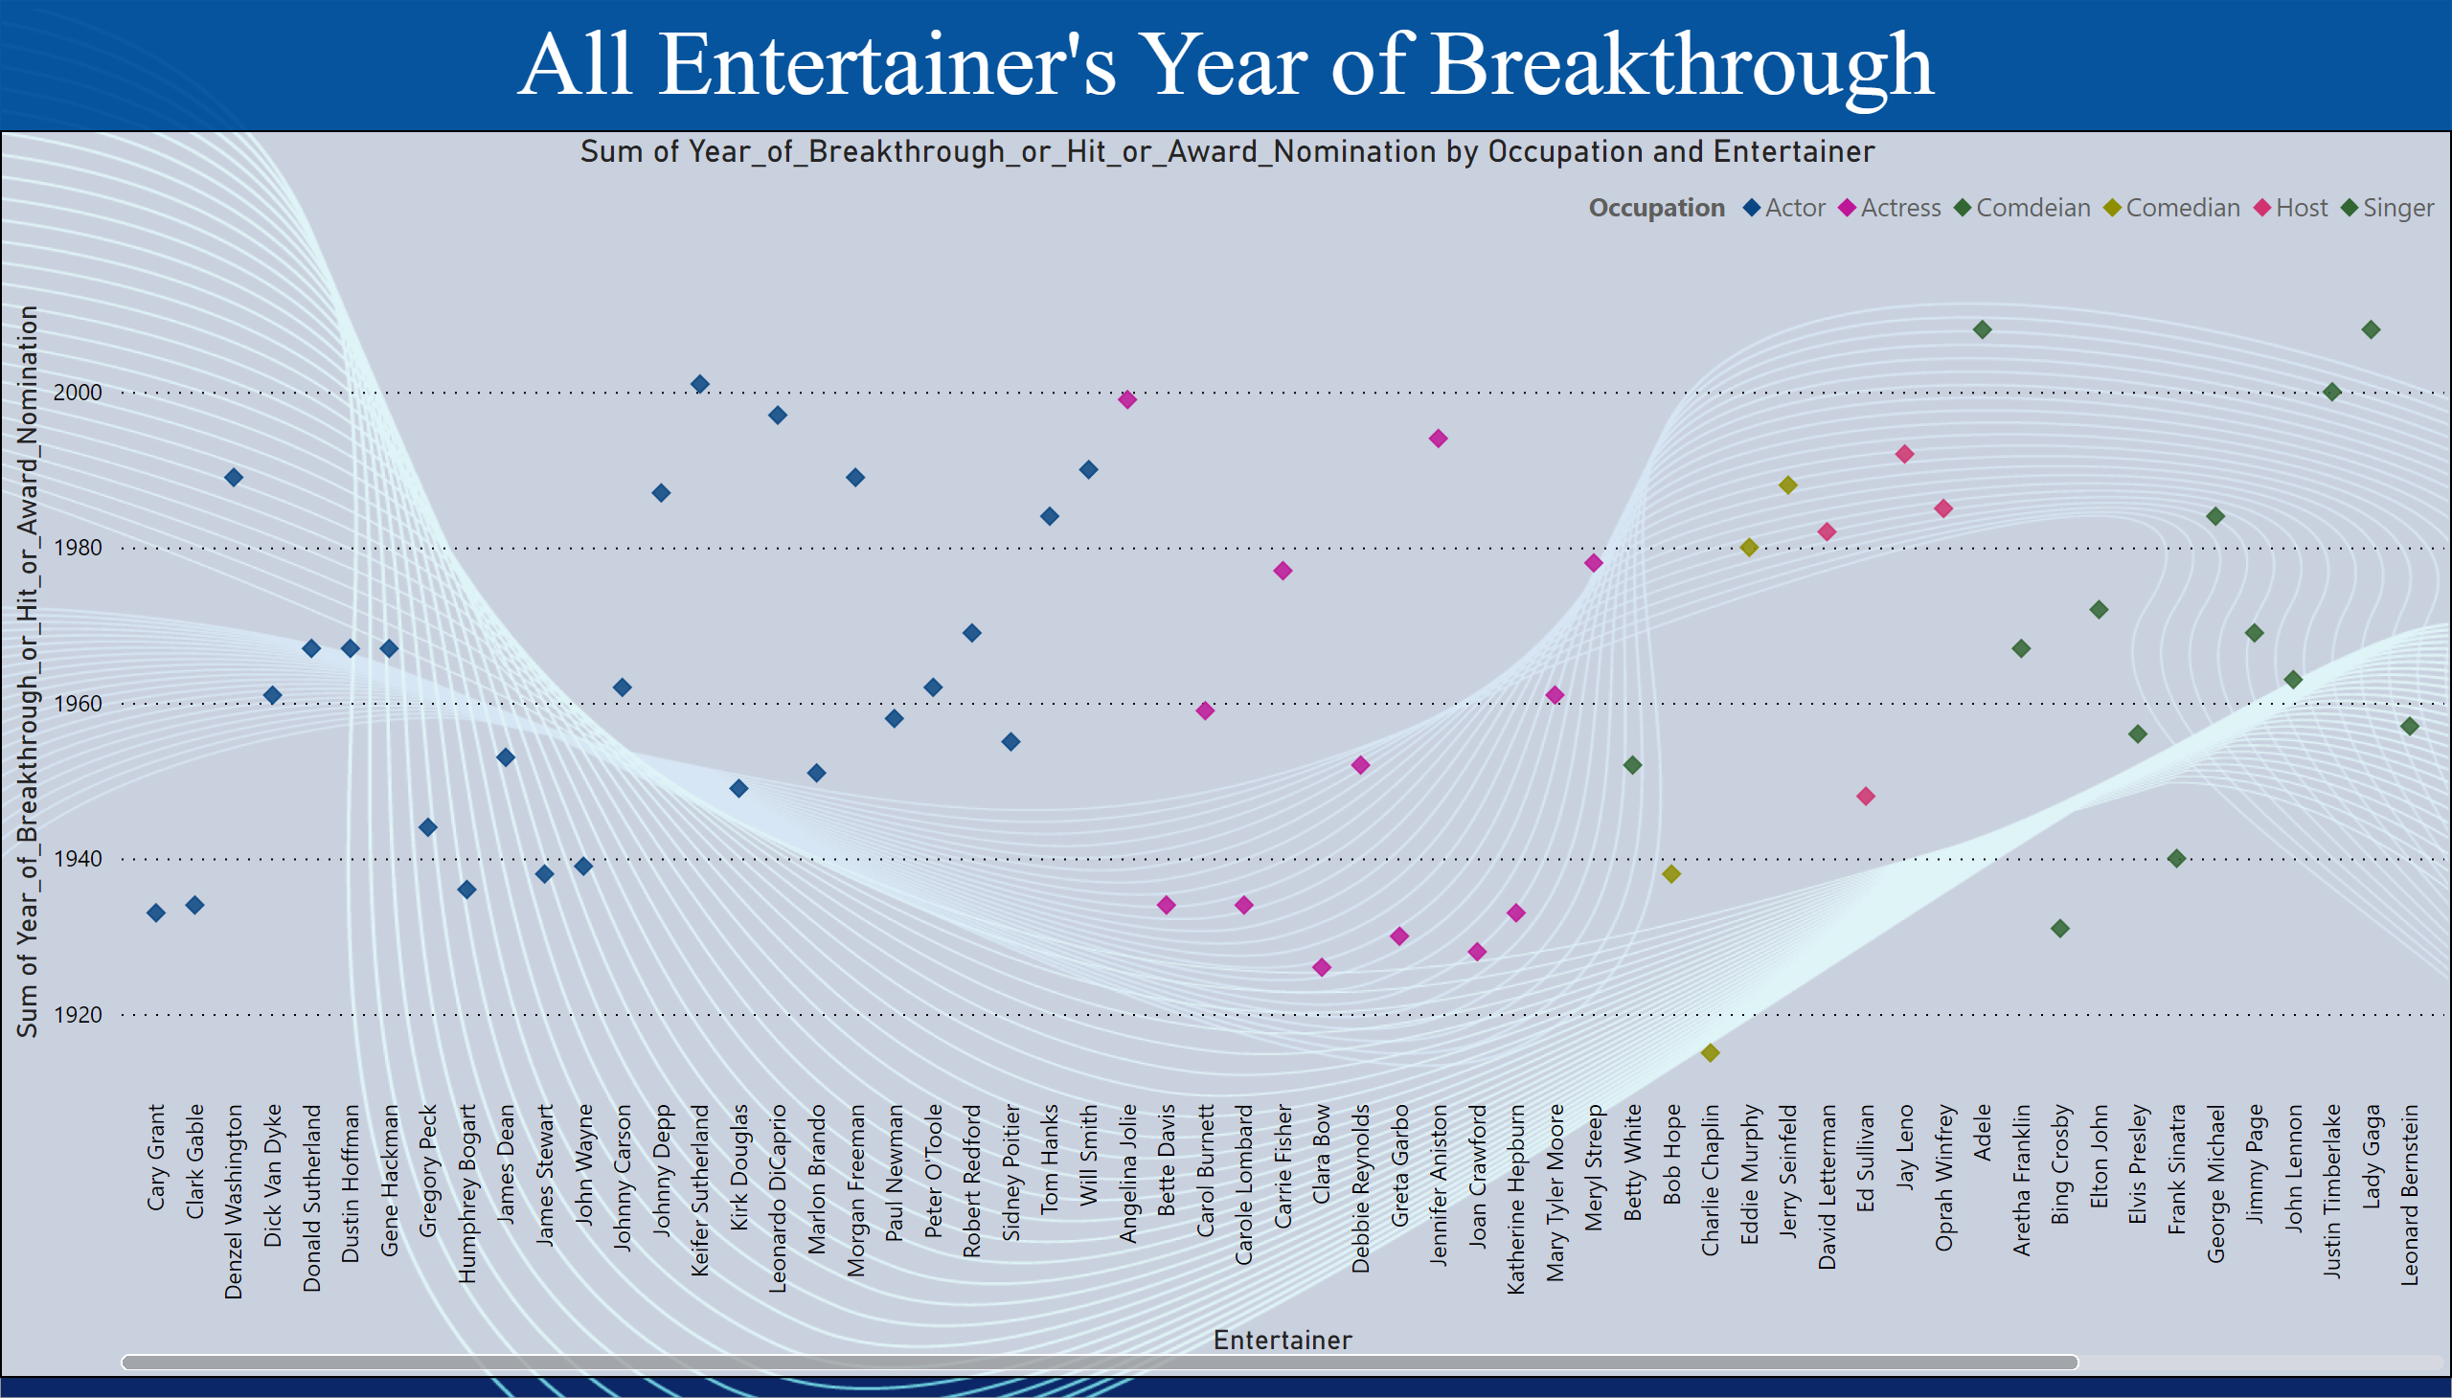
Year of Breakthrough
According to the aforementioned graph, the majority of breakthroughs for performers occurred between the 1940s and 1960s.
Notes:
textbox
No alt text provided
scatterChart
No alt text provided

Slide 5
Deployment
The final report is published in Power BI service. Then the link is shared to client. Below is the document link to access the report.
Power BI service Link: https://app.powerbi.com/view?r=eyJrIjoiYzkxNzc5NTItNmM2OC00MWRhLWExYWEtZGY1ZGMzNjAyMTc4IiwidCI6IjFlODI2NjA0LWQ0Y2QtNGUyYi04MWQ1LWVkYzRjZDJiYjFiOSJ9
Also the entire project is uploaded in Novypro.com for public use.
Novy Pro Link: https://www.novypro.com/project/pbix

